Slide 1

Crown Identification
Tushar Kulkarni
Machine Learning Engineer Intern
Mentors Sergei Azernikov, Andrey Gubenko, Chih-Chun Lin

Slide 2
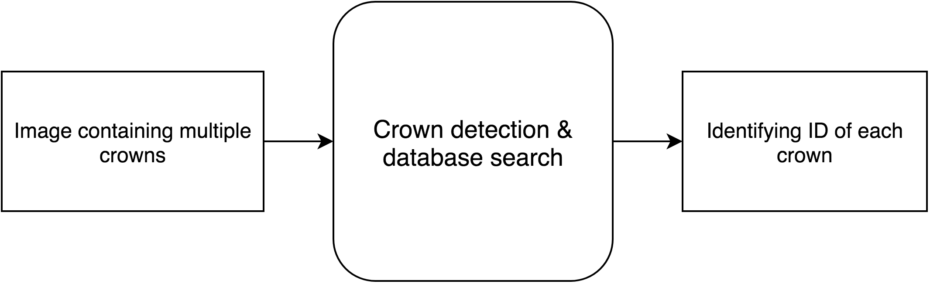
Crown Identification
Why do we need this system?
Fast identification of unknown crowns
No dependency over other external identification methods e.g. Barcode, Text Labels
One of the reasons why one to one pixel matching is a bad idea
Why Machine Learning and Computer Vision?
Removes redundant information e.g. color, contrast, perspective, lighting (to certain extent)
Recognizes patterns in crown rather than actual crown (features)

Slide 3
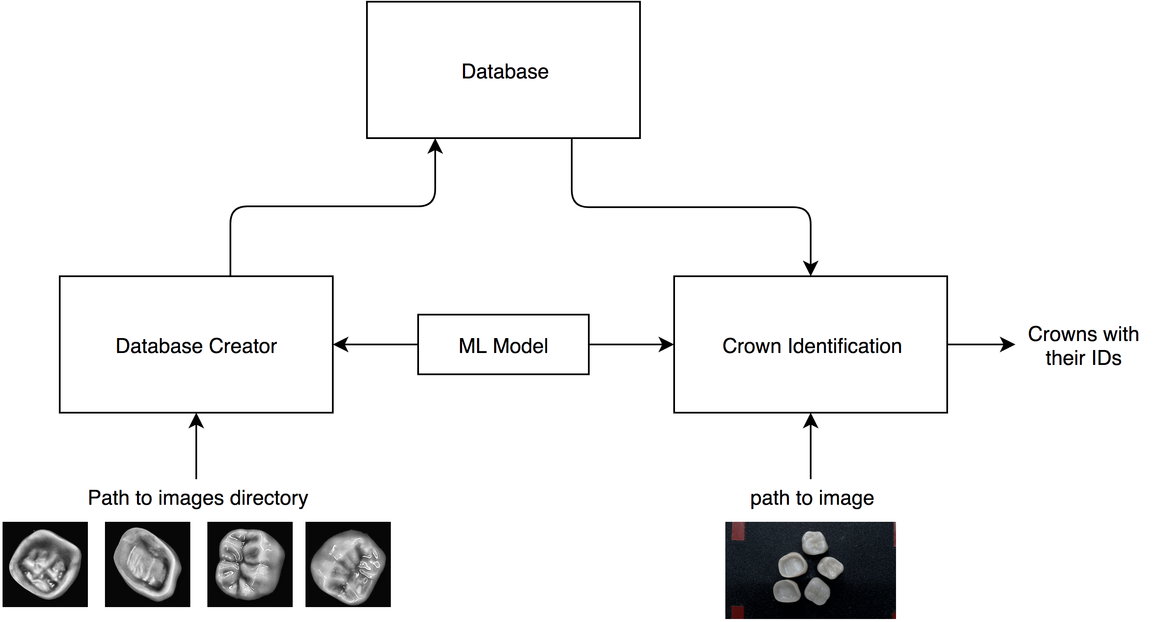
Crown Identification
Block Diagram

Slide 4
Crown Identification

